Slide 1




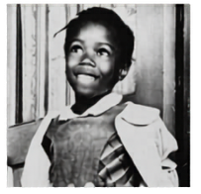
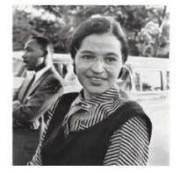
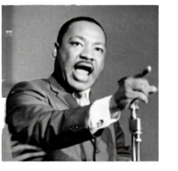
Year 5 Civil Rights Movement Knowledge Organiser
AMERICAN TIMELINE
1855
1954
1955
1960
1963
1954
1965
2008
2020
Abolition of slavery
Little Rock Nine
Montgomery
Bus Protest
Ruby Bridges goes to school
March on Washington
Civil Rights Act
Voting Rights Act
1st black president of USA
George Floyd killed
BLM movement
Key Vocabulary
Civil Rights | The rights of citizens to political and social freedom and equality (e.g., voting, fair treatment, no discrimination)
Segregation | The enforced separation of different racial groups in daily life, such as in schools, transport, and public places.
Integration | The process of ending segregation and bringing people of different races together in equal settings.
Discrimination | Treating people unfairly because of their race, gender, religion, or other characteristics.
Racism | Prejudice or discrimination against someone based on their race.
Nonviolent Protest | Peaceful methods of protest (e.g., marches, sit-ins) without using violence.
Civil Disobedience | Breaking laws peacefully to show that they are unfair.
Boycott | Refusing to buy or use something as a protest (e.g., Montgomery Bus Boycott).
Sit-in | A protest where people sit in a place and refuse to leave (often used to challenge segregated spaces).
· March | A large group of people walking together to protest or support a cause (e.g., March on Washington).
Ruby Bridges
Rosa Parks
Martin Luther King Jr.
·
  Jim Crow Laws – Different schools. Ruby had to walk to a black school.
  November 6th, 1960 – 1st African American child to walk into an all-white elementary school when she was 6.
  1954 Brown v. Board of Education-racial segregation in schools against the law.
  4 US Marshalls encarted her for 6 months.
  Protesters attacked and threatened Ruby and her family.
  Father lost job and grandparents lost farming land.
  Taught 1 year on her own with Mrs Henry.
  In her 2nd year, she became fully integrated into a class.
  Jim Crow Laws - Buses used to be segregated. Blacks were at the back and give their seats if there were none available.
  1st December 1955 in Montgomery, Rosa Parks refused to give up her seat to a white passenger.
  Rosa was arrested and spent a few hours in jail.
  She lost her job as a seamstress and had to move to Detroit.
  The Montgomery Bus Boycott lasted for 361 days. (peaceful protest by 100%)
  The law was changed stating segregation laws should no longer be recognised.
  Civil rights leader and minister
  1st experienced segregation when he was 6 – not allowed to play with best friends.
  Helped to lead the Montgomery Boycott.
  Inspired by Gandhi – peaceful protests.
  1963 – Made “I Have a Dream” speech at the March on Washington to 250,000 people.
  1964 – Awarded Nobel Peace Prize
  21st – assassinated the day after giving a speech, by James Earl Ray.
  3rd Monday in January – Martin Luther King Jr. day. (American holiday)

Slide 2


