Slide 1

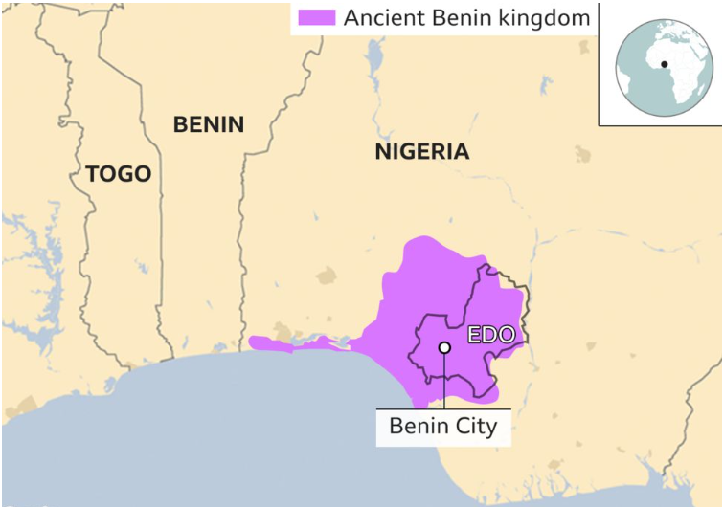
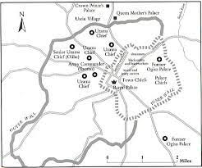
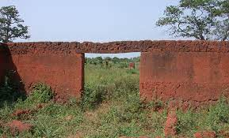
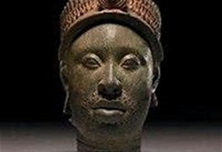
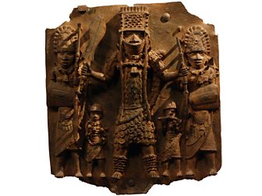
Year 6 History –The Kingdom of Benin
15000 to 3000 BC
3,300 BC
800 BC
700 BC
43 AD
410
AD
793 AD
900 AD
1066AD
1485 AD
1666 AD
1837 AD
1914 to 1918
1939 to 1945
Now
3100 BC
Stone Age
Bronze Age
Ancient Egyptians
Iron Age
Ancient Greeks
Roman Britain
Anglo Saxons
Vikings
Benin Kingdom formed.
Normans
Tudors
Great Fire of London
Victorians
World War I
World War II
Me!
What You Should Know Already
Important Vocabulary
1 | Animism | A religion that teaches that humans, animals and non- living objects all have souls or spirits.
2 | Cowrie shells | A seashell which Europeans used as a kind of money to trade with African leaders.
3 | Colonisation | When invades take over a country by force and live there, claiming the land for their native country.
4 | Civil war | A war between people who live in the same country.
5 | Oba | The Yoruba word for a king or chief . First used by Oba Eweka, AD 1180.
6 | Ogisos | The first kings of Benin. Ogisos means “ Rulers of the Sky”
7 | Ohen | A religious holy person who performed ceremonies in the kingdom of Benin.
8 | Yoruba | Yoruba is a language spoken in Nigeria and West Africa. It is spoken by the ethnic Yoruba people.
9 | Yam | The main crop of the Benin civilization was the yam (sweet potato). Also, okra, beans and peppers.
Benin City is the location of the ancient Kingdom of Benin. It is located in Nigeria, which is in the west of Africa. The Ancient Kingdom of Benin is NOT located in the modern country of Benin, this is a different country in Africa.
The location of the continent of Africa and be able to use an atlas to locate countries, cities and physical features.
How to use a timeline to place periods of history I have learnt about.
Use the vocabulary – BC, AD, era, decade, century correctly.
understand that people’s experiences over history varied depending upon their different social status.
Select reliable information from a variety of primary and secondary sources to research and answer questions.
begin to understand that history is rewritten as we learn more about the past.
The Walls of Benin are a series of earth banks and ditches, called Iya, in the area around present-day Benin City. They were built for protection of the settlement.
Olokun – the god of water and wealth.
A brass plaque showing an Oba.

Slide 2
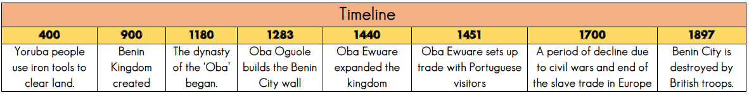
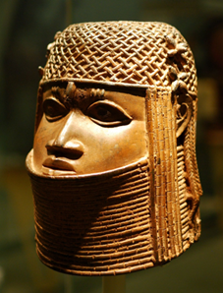
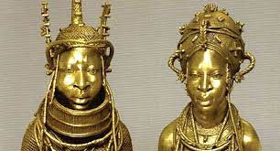
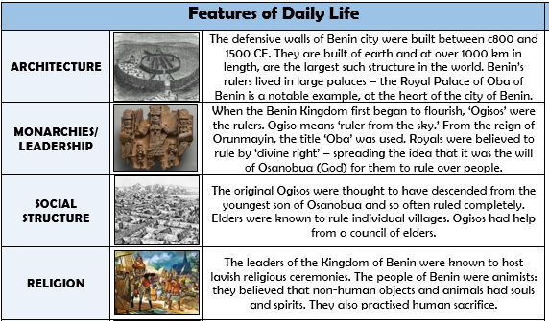
Key Facts
1 | Between AD 900 and AD 1180 the people of Benin lived in small communities that joined together to form a Kingdom called Igodomigodo which was later changed to Edo.
2 | The early people were ruled by a dynasty of kings called ‘Ogisos’. 900-1180 AD.
3 | Oba Eweke was the first of a new dynasty of kings called the Obas, crowned around 1180. He was from the Yoruba people.
4 | The Edo people begin trading with the Portuguese, who called the place ‘Benin’.
5 | The Kingdom of Benin traded goods like pepper, ivory, cloth, leopard skins, beads, rubber, palm oil and precious stones to European traders.
6 | In the middle ages, the Benin Kingdom became heavily involved in the slave trade, capturing rival peoples and selling them to Europeans.
7 | Around 1700, a series of civil wars within Benin lead to a decline in the power of the kingdom.
There are no written texts about the people of Benin. However, they had a rich oral culture. They would tell their history, myths and legends and these would be passed on through word of mouth. Treasures of wood, bronze, ivory and metal made their way into Europe through trade or plunder and astounded people with their high degree of artistry and craftsmanship.
Other Sources of Information.
Websites - https://school-learningzone.co.uk/
https://kids.britannica.com/students/article/kingdom-of-Benin
https://www.bbc.co.uk/bitesize/topics/zpvckqt/articles/z3n7mp3
Brilliant Books: Here are some books that you might find interesting:
‘Kingdom of Benin Short Stories ‘ and ‘Diary of An Edo Princess’ both by Fidelia Nimmons
Tales from Africa by Kathleen Arnott
Daily Life in Ancient Benin (Daily Life in Ancient Civilizations) by Paul Mason.
History Detectives - Ancient Benin 900-1897 by Alice Hardman.

