Slide 1

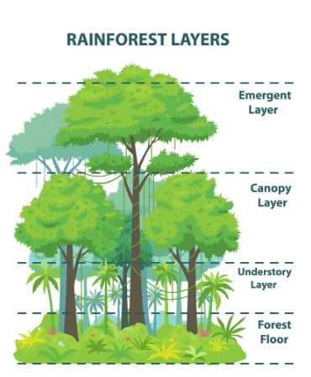
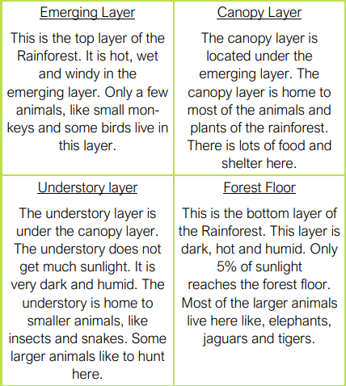
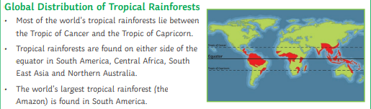
Year 6 Geography – Rainforests
What You Should Know Already
Important Vocabulary
Biodiversity | A large variety of plant and animal life in a particular habitat, a high level of which is usually considered to be important.
Biome | Large-scale ecosystems defined by physical factors such as climate, relief (mountainous, near the coast or inland), geology, vegetation and latitude.
Climate | The usual weather conditions, averaged over many years.
Deforestation | The action of cutting, clearing and removal of a large area of trees.
Ecosystem | A community of plants and animals that depend on each other to survive.
Endangered | A species that has been categorised as very likely to become extinct.
Extinction | The extinction of a species of animal or plant is the death of all its remaining living members
Humid | Having high levels of moisture (water vapour) in the air.
Indigenous | originating or occurring naturally in a particular place; native of a particular country or location.
Rainforest | A dense forest, containing a large variety of plants and animals, usually found in tropical areas with high rainfall.
Sustainability | Using natural resources carefully to maintain a ecological balance that makes sure the resources are still available for future generations.
The position and significance of latitude, longitude, Equator, Northern Hemisphere, Southern Hemisphere, the Tropics of Cancer and Capricorn, Arctic and Antarctic Circle, the Prime/Greenwich Meridian and time zones.
Be able to locate the world’s countries, using a variety of maps identifying the environmental regions, key physical and human characteristics, and major cities.
Use the terms human and physical geography accurately and using geographical vocabulary appropriately.
Describe and understand key aspects of physical geography including vegetation belts and biomes.

Slide 2
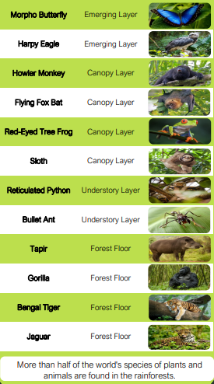
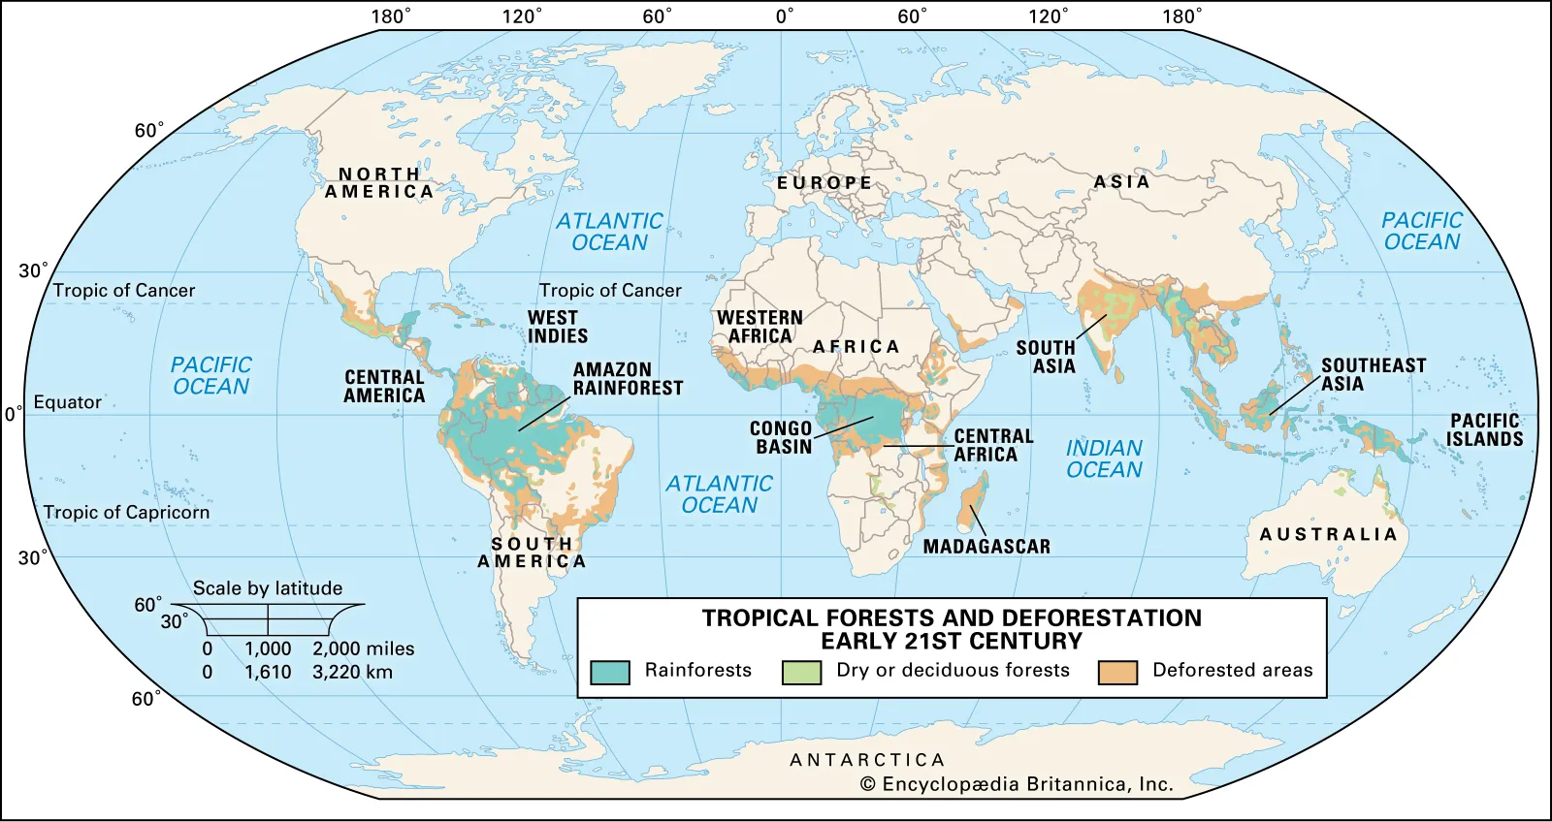

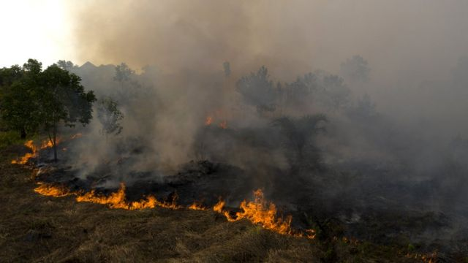
Animals of the Rainforest
Deforestation
Causes
To make space for farming crops and animals
Chopping down trees for wood and paper products
To make space and build roads to mine for metals, gold and diamonds
To dig for oil
To flood areas to make dams and generate electricity
Effects
Half of the tropical rainforests we had in the past have now gone
Extinction of large numbers of animals and plants
Levels of oxygen in the air are decreasing and carbon dioxide are increasing
Loss of animal habitats
Loss of living space for indigenous tribes
Soil erosion
Flooding
Solutions
Persuade farmers to avoid removing trees
Education of people all around the world
Change peoples buying habits
Government laws and incentives
Reforestation
Other Sources of Information.
Websites
https://www.nationalgeographic.org/encyclopedia/rain-forest/
https://www.rainforest-alliance.org/
Planet Earth - episode 8- Jungles available on BBC iplayer
Brilliant Books: :
The Explorer – Katherine Rundell
Running Wild – Michael Morpurgo
Expedition Diaries: Borneo Rainforest- Simon Chapman
Between July and October (during Indonesia's dry season) many farmers clear vegetation for palm oil, pulp and paper plantations using the slash-and-burn method. This often results in uncontrolled burning of the rainforest and a dangerous polluting haze spreads across South East Asia for many weeks.

