Slide 1

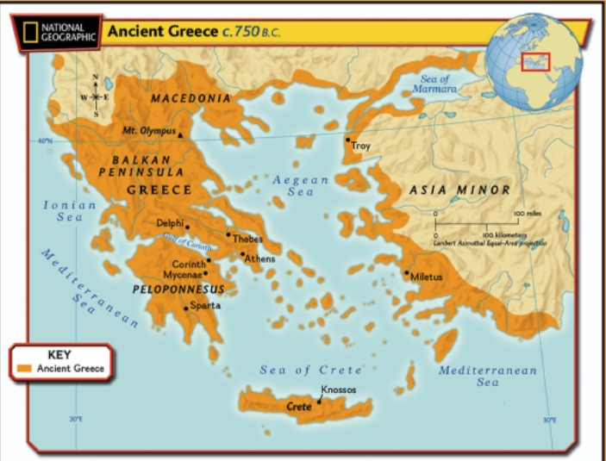
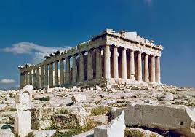
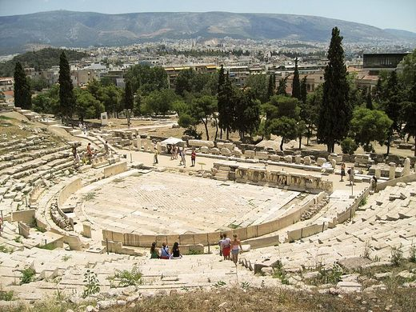
Year 3 History – Ancient Greeks
15000 to 3000 BC
3,300 BC
800 BC
700 BC
43 AD
410
AD
793 AD
900 AD
1066AD
1485 AD
1666 AD
1837 AD
1914 to 1918
1939 to 1945
Now
3100 BC
Stone Age
Bronze Age
Ancient Egyptians
Iron Age
Ancient Greeks
Roman Britain
Anglo Saxons
Vikings
Benin Kingdom formed.
Normans
Tudors
Great Fire of London
Victorians
World War I
World War II
Me!
What You Should Know Already
Important Vocabulary
1 | ancient | Something from a very long time ago.
2 | architecture | The art and science of designing and creating buildings.
3 | civilisation | A group of people living with well-developed rules and an organised government, often where learning, sport and arts are important.
4 | city states | Ancient Greece was divided into small areas around cities, each with their own governments, laws and army.
5 | democracy | Democracy is a system where the people of a country or state are involved in the way it is run.
6 | empire | A group of countries or states that is ruled by one ruler or country.
7 | legacies | Things that live on after someone dies or after a civilisation ends.
8 | merchant | A person who buys or sells goods in large quantities
9 | seafaring | Using the sea to trade, transport goods and people. The Ancient Greeks were seafaring.
10 | myth | An ancient story told in a particular country or culture to explain extraordinary events. Often contain strange creatures and different Gods.
11 | source | Information and objects that help us understand about the past.
Greece is a country in the continent of Europe.
The climate of Greece is slightly different to UK – warmer and drier.
I am beginning to find information using the internet, digital maps, atlases and books.
BC means Before Christ and AD means Anno Domini.
This is the Theatre of Dionysus in Athens. It was probably built during the 6th century BC, The word 'theatre' is Greek. Most modern theatres follow the Greek plan/design. Theatre and music were important to ancient Greeks.
The Parthenon is an ancient Greek temple in the city of Athens. It is dedicated to the goddess Athena, the Goddess of Wisdom. It was completed in 432 BC.
Notes:
tol

Slide 2
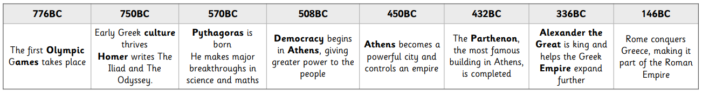
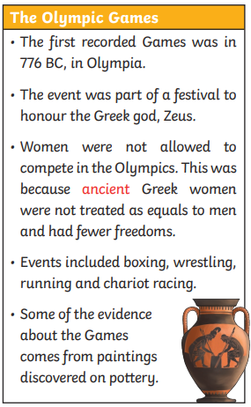
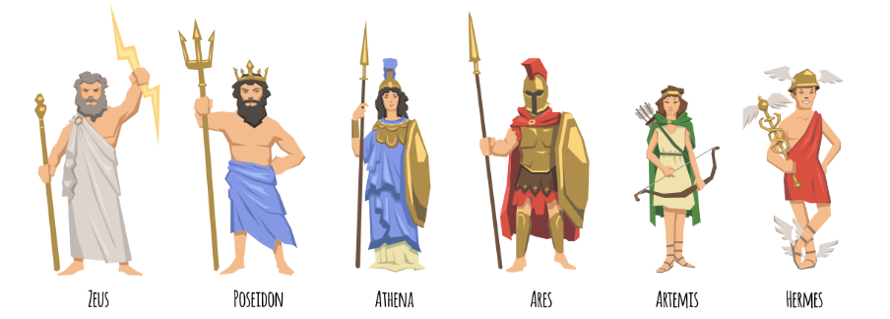
Timeline
City States
Homes -Ancient Greek homes were built around a courtyard, which was the centre of activity. Around the courtyard were the rooms of the house, including work rooms and bedrooms.
Ancient Greece was not a country. It was made up of city states. There were often battles between these city states but sometimes they would join together against a common enemy. Important city states of ancient Greece included Athens, Corinth and Sparta.
Clothes -The Ancient Greeks wore a tunic called a ‘chitin’ – worn by both men and women. These were fastened together at different places and a belt was also normally worn at the waist. Chitins came in many sizes and colours.
Other Sources of Information.
Democracy
Websites
1. https://greece.mrdonn.org/geography.html
2. http://www.primaryhomeworkhelp.co.uk/Greece.html
3. https://www.bbc.co.uk/bitesize/topics/z87tn39
Brilliant Books: Here are some reading books that you might find interesting:
The Ancient Greek Myth Collection by Orchard Books (16 short story books)
See Inside Ancient Greece by Ro
b Lloyd Jones.
Mission To Marathon by Geoffrey Trease
What’s Your Angle, Pythagoras? by Julie Ellis
Around 500BC, democracy was introduced to the city state of Athens. Listening to the opinions of other people and talking (debating) about issues are an important part of democracy.

