Slide 1

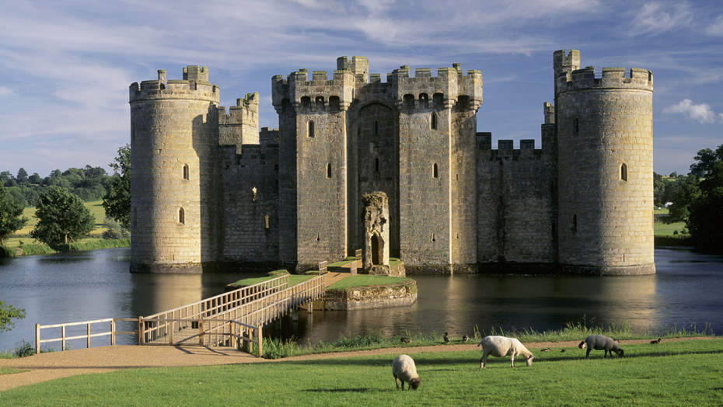
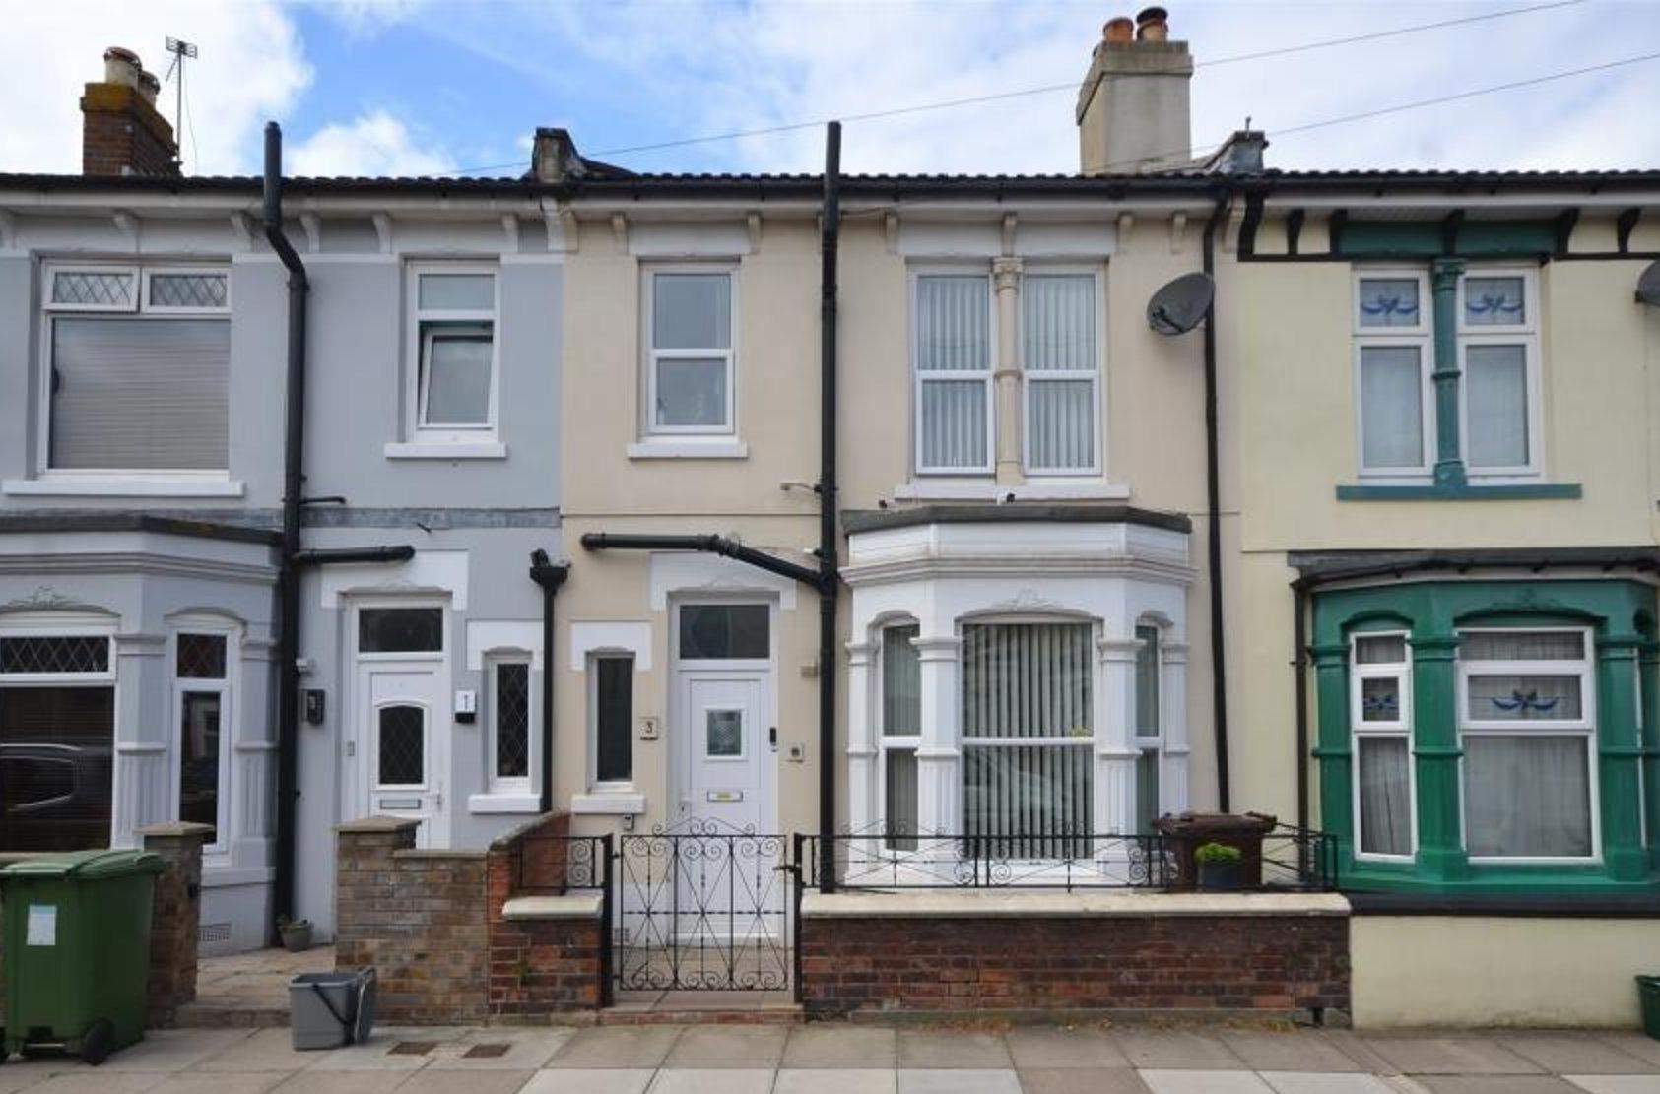
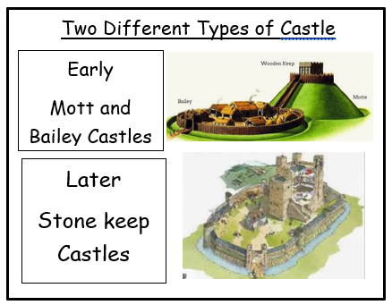
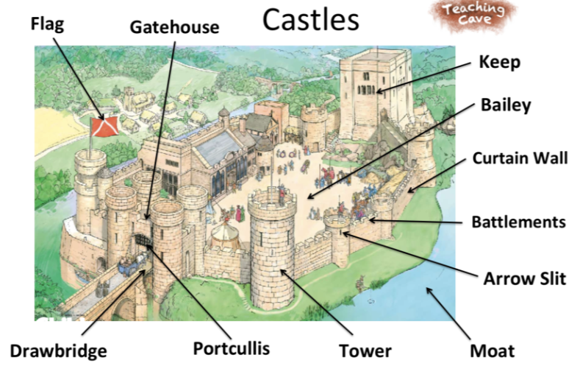
Year 2 History – Raising the Drawbridge
15000 to 3000 BC
3,300 BC
800 BC
700 BC
43 AD
410
AD
793 AD
900 AD
1066AD
1485 AD
1666 AD
1837 AD
1914 to 1918
1939 to 1945
Now
3100 BC
Stone Age
Bronze Age
Ancient Egyptians
Iron Age
Ancient Greeks
Roman Britain
Anglo Saxons
Vikings
Benin Kingdom formed.
Normans
Tudors
Great Fire of London
Victorians
World War I
World War II
Me!
What You Should Know Already
Castle | Modern House
Lots of large rooms for lots of people | Smaller rooms for just one family
Small windows for safety | Large windows to let in light and fresh air
Thick walls that are made of stone and not painted. | Walls made of brick and painted to look pretty
Important Vocabulary
Bailey | A courtyard in the centre of a castle surrounded by a curtain wall.
Castle | A large strong building that was built to protect the people living inside.
Drawbridge | A moveable bridge that reached over the moat to allow people to enter the castle safely.
Keep | A fortified tower inside the castle.
Knight | A man who served the King or queen as a mounted soldier in armour.
Moat | A ditch of deep water surrounding a castle that made it difficult to attack.
Monarch | A person who reigns over a kingdom or empire such as a King or Queen
Portcullis | A strong iron gate that added extra protection to the castle entrance.
Turret | A small tower on the castle, at the corner or on the top of a large tower.
Fiction | Something that is not real. It is made up or imagined.
Castle are made of stone.
King and Queens lived in castles.
We live in the country of England in the United Kingdom.
There have been changes to how people live over time.
Events that happened in the past have made a difference to how we live our lives today.
I know what type of housing I live in and I know the members of my family that I live with.
The Parts of a Castle

Slide 2
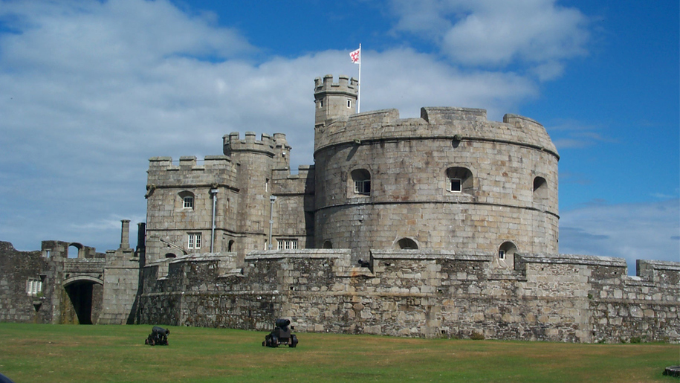
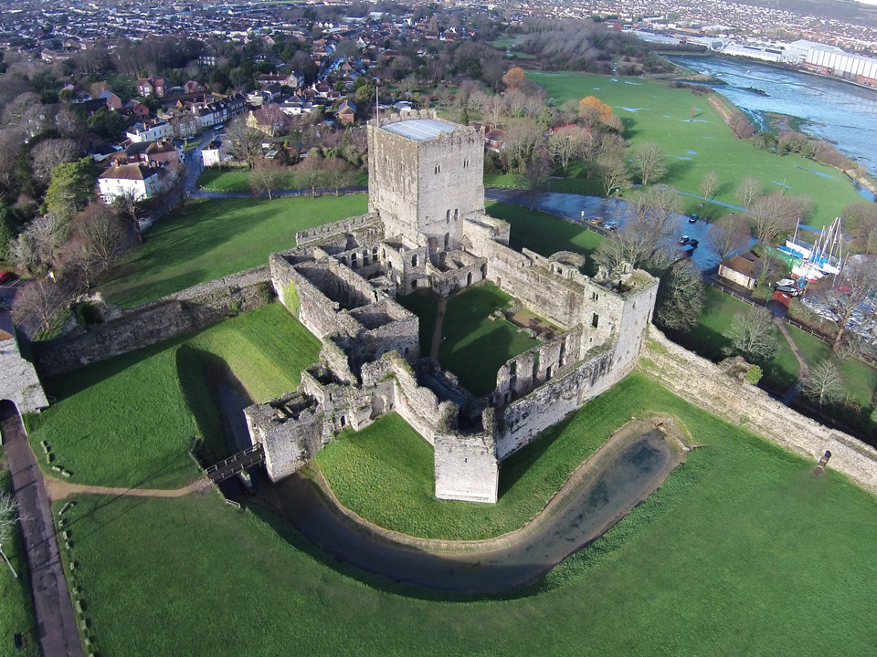
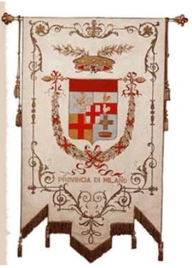
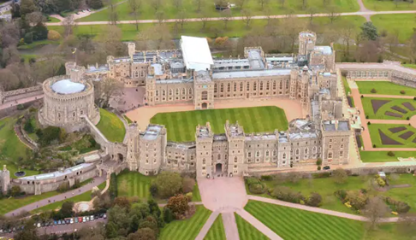
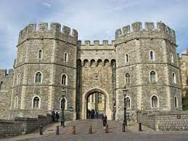
Geography - Castles
Key People
William the Conqueror | When William invaded England in 1066 he set about building castles in the towns he won. He built Windsor Castle, The Tower of London and Dover Castle.
Henry VIII | He became King of England in 1509 and his reign lasted for 38 years. He wanted to show his wealth so built lots of castles including Southsea Castle.
Queen Elizabeth II | This year is the Queen’s Platinum Jubilee – she has been Queen of the United Kingdom for 70 years. She lives in Buckingham Palace and Windsor Castle.
St George | Patron saint of England, who has lots of fictional stories written about his brave deeds. He never visited England and was not an English knight.
Southsea Castle, also known as South Castle and Portsea Castle, is an artillery fort built by Henry VIII in 1544.
Portchester Castle is a Saxon fort. The castle’s location has made it an important part of Portsmouth defence for hundreds of years. The keep was probably built later in the late 11th century.
Long, streaming flags called banners showed the symbols of the lord of the castle.
Other Sources of Information.
Websites
https://www.dkfindout.com/uk/history/castles/
http://www.primaryhomeworkhelp.co.uk/castles/motteandbailey.htm
https://www.theschoolrun.com/homeworkhelp/castles
Brilliant Books:
The Knight Who Said "No!“ by Lucy Rowland & Kate Hindley
The Naughty Knight by Valerie Thomas & Korky Paul
The Secret Diary of Thomas Snoop, Tudor Boy Spy (by Philip Ardagh
The Hawk of the Cross – Danna Smith
Castle by Colin Thompson
Windsor Castle is the oldest and largest occupied castle in the world. William the Conqueror started building the castle in the 11th century. It has been the home of 39 monarchs. Today , the Queen spends most of her private weekends at the Castle.

