Slide 1

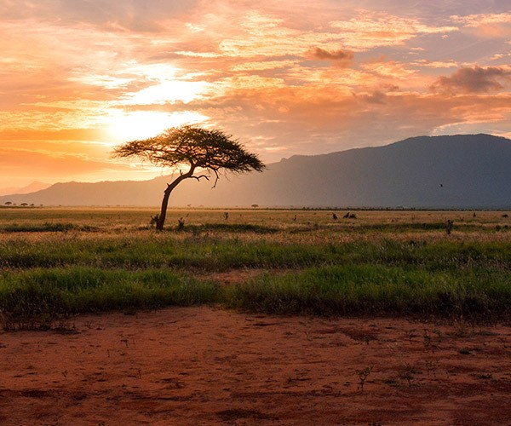
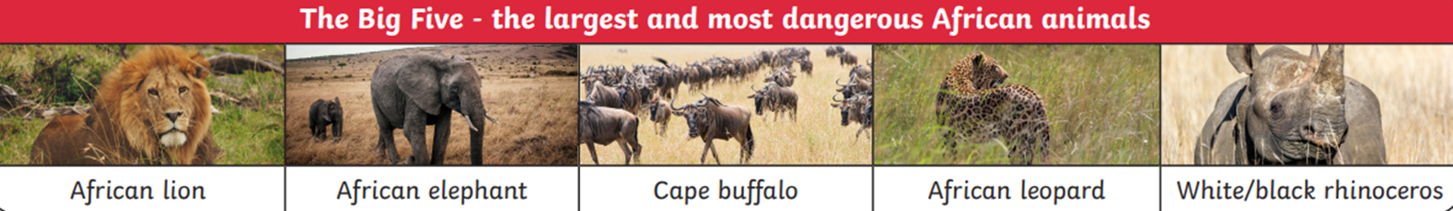
Year 1 Geography – Let’s Go Safari
What You Should Know Already
Important Vocabulary
cottage | A small house made of brick often found in villages in the UK. As you can see it.
culture | The way of life of a group of people, including, beliefs, food, clothing and language.
continent | A large area of land joined together and made up of different countries. There are 7 continents that make up the planet Earth.
endangered | When a species of animal or plant is at risk of becoming extinct (no longer existing).
landscape | An area of land.
national park | A protected area of land where animals and plants are safe from development and hunting.
safari | A safari is a journey when people search for animals in their natural environment.
thatched hut | A small building made often of mud with a straw roof.
tourist | A person who is visiting an area on holiday.
I live the city of Portsmouth.
Portsmouth is in the United Kingdom, which is part of the continent called Europe.
The ocean closest to the UK is the Atlantic Ocean.
That there are other continents and oceans that make up the world.
Africa is a continent made up of lots of different countries. It is a very dry continent with little rainfall. The most common landscape is dry grasslands called savannahs, with a few small trees growing near water holes.
Today, most of Africa’s amazing wildlife can be found in the national parks where the animals are protected as many animals are becoming endangered.

Slide 2
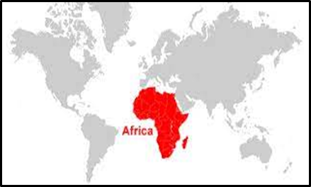
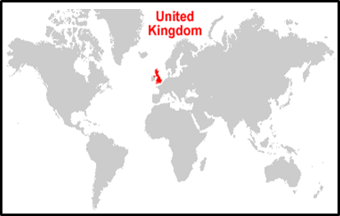
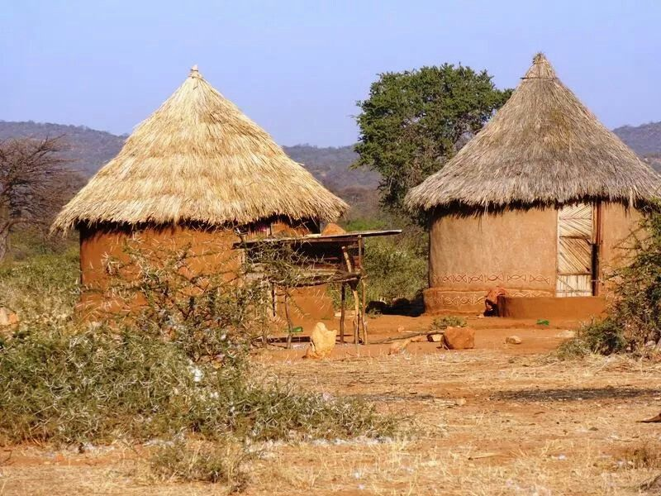
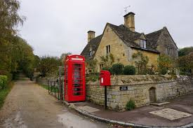
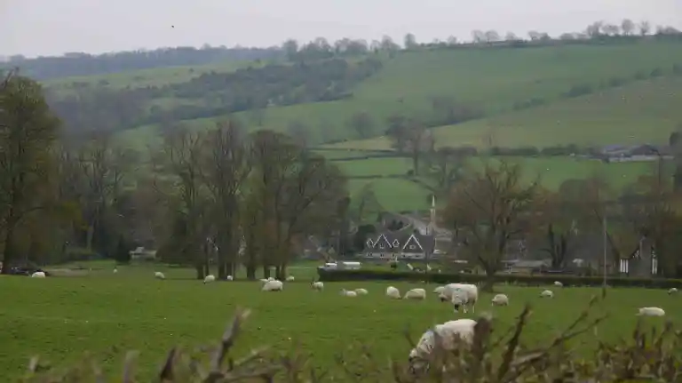
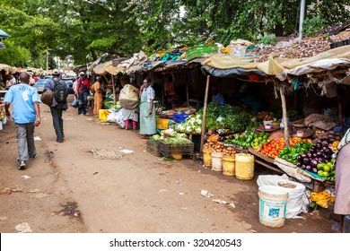
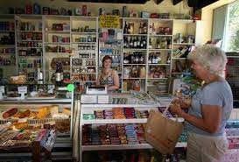
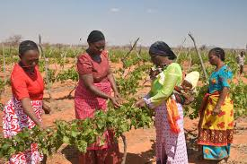
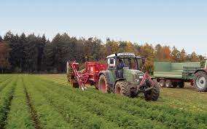
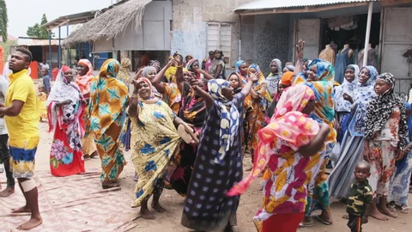
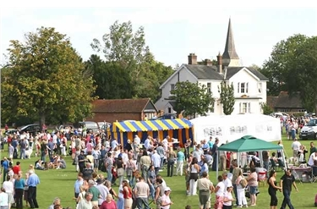
 | Traditional Kenyan Village | Traditional UK Village
Houses
Shopping
Farming
Village Party
The English Countryside
In the UK, the landscape is green with lots of trees and plants growing in the warm, wet summer weather.
The land is divided into small fields which are filled with farm animals looked after by farmers.
Other Sources of Information.
Websites
https://www.dkfindout.com/uk/earth/continents/africa/
https://kids.nationalgeographic.com/
https://www.bbc.co.uk/programmes/p010jc6p/episodes/guide - Africa series by David Attenbrough
Brilliant Books: :
Lila and the Secret of Rain – David Conway The Hunter – Paul Geraghty
One Day on our Blue Planet – Ella Baily
Handa’s Surprise – Eileen Browne Anna Hibiscus – Atinuke
Meerkat Mail – Emily Gravett

