Slide 1

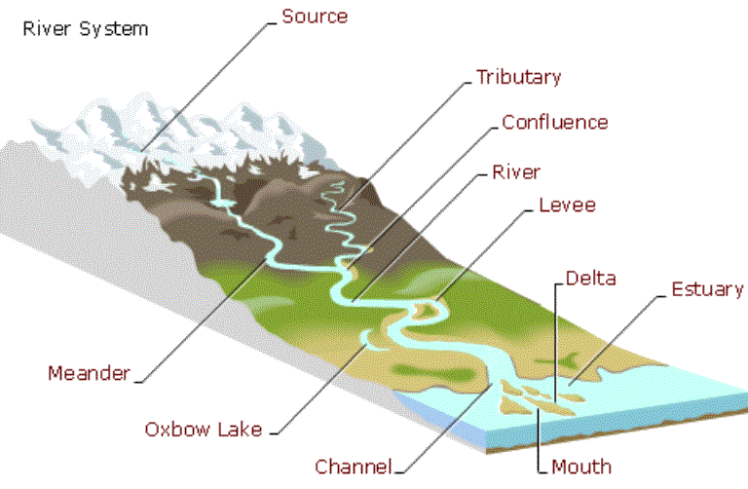
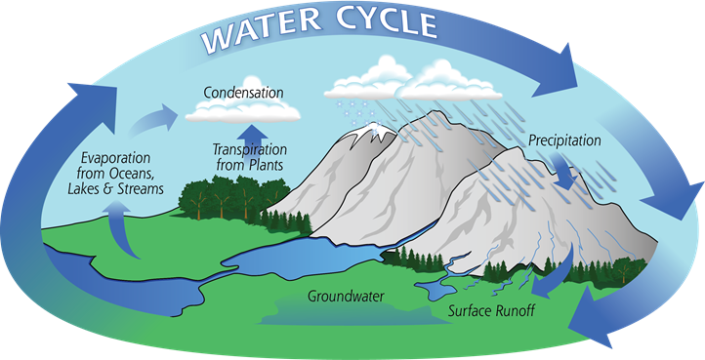
Year 5 Geography – Wild Waters
Important Vocabulary
transpiration | The loss of water vapour from plants to the atmosphere.
evaporation | The process of turning liquid into a vapour.
condensation | Water which collects as droplets on a cold surface when humid air is in contact with it
precipitation | Rain, snow, sleet or hail that falls to or condenses on the ground.
Hydroelectric power | This is the electrical power produced by capturing the power of falling or fast flowing water using special machinery called turbines.
tributaries | Rivers and streams that join up with another river
meander | A curve or bend in a river, usually in the slower middle section.
oxbow Lakes | U-shaped lakes that form when parts of a meandering river join and then become separated from the rest of the river.
dam | Dams are large walls, which are built to hold water back, usually in a reservoir.
What You Should Know Already
Water moves around the planet in a continuous cycle – The Water Cycle.
Water is essential to all animal and plant life.
Parts of the world suffer from chronic shortages of water whilst other parts of the world have plenty.
Water exists as a liquid (water) a solid (ice and snow) and a gas (water vapour).

Slide 2
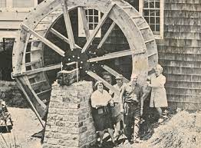
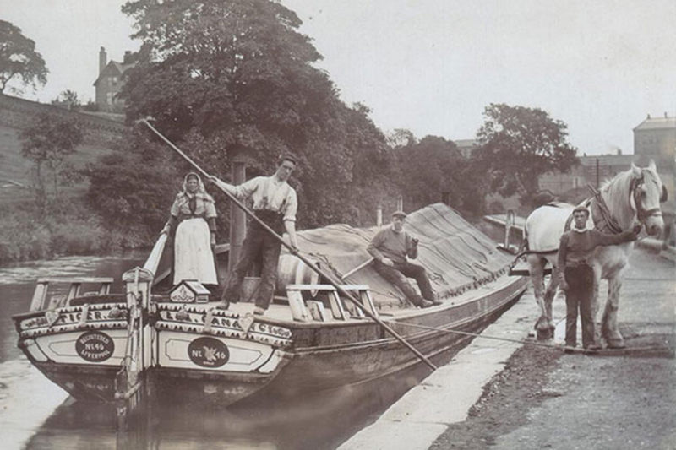
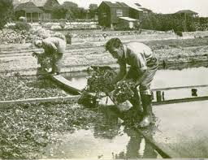
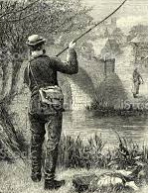
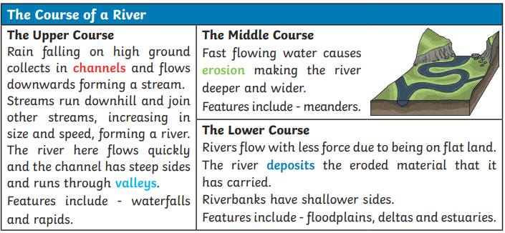
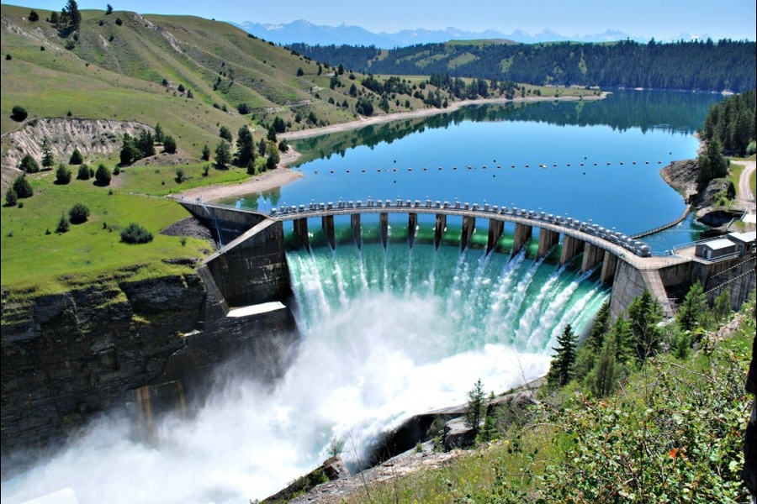
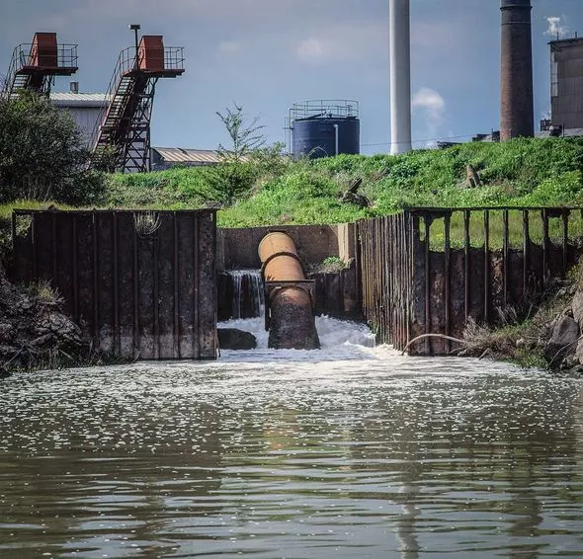
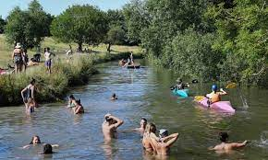
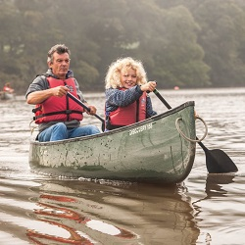
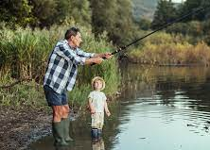
Key Facts I Need To Know
1 | Rivers carry rainwater and melt water downhill (from their source in the mountain) to other rivers, lakes or the ocean.
2 | Some rivers join up with other rivers (tributaries). The point where they meet is called a confluence.
3 | The way we use rivers has changed over time.
4 | The path of a river will change over time as it floods and erodes the surrounding landscape.
5 | The world’s longest river is the Nile in Africa. It is 4,130 miles long.
6 | The longest rivers in Britain are the Severn (220 miles long) and the Thames (215 miles long).
How we used rivers in the past?
Transporting goods around the country.
Providing water power for mills.
Fishing for food to eat and rivers provided drinking water
Providing water for irrigation to grow food such as watercress.
How we use rivers today?
Dams on rivers provide drinking water and the force of the water can produce hydro-electric power.
Factories using river water for cooling and to discharge waste in.
Other Sources of Information.
Websites - https://www.nationalgeographic.org/encyclopedia/river/
https://www.bbc.co.uk/bitesize/topics/z849q6f/articles/z7w8pg8
Brilliant Books: : - Journey to the River Sea by Eva Ibbotson
The River Singers by Tom Moorhouse Kensuke's Kingdom - Michael Morpurgo
Today rivers are used for leisure activities – swimming, canoeing and fishing.

