Slide 1

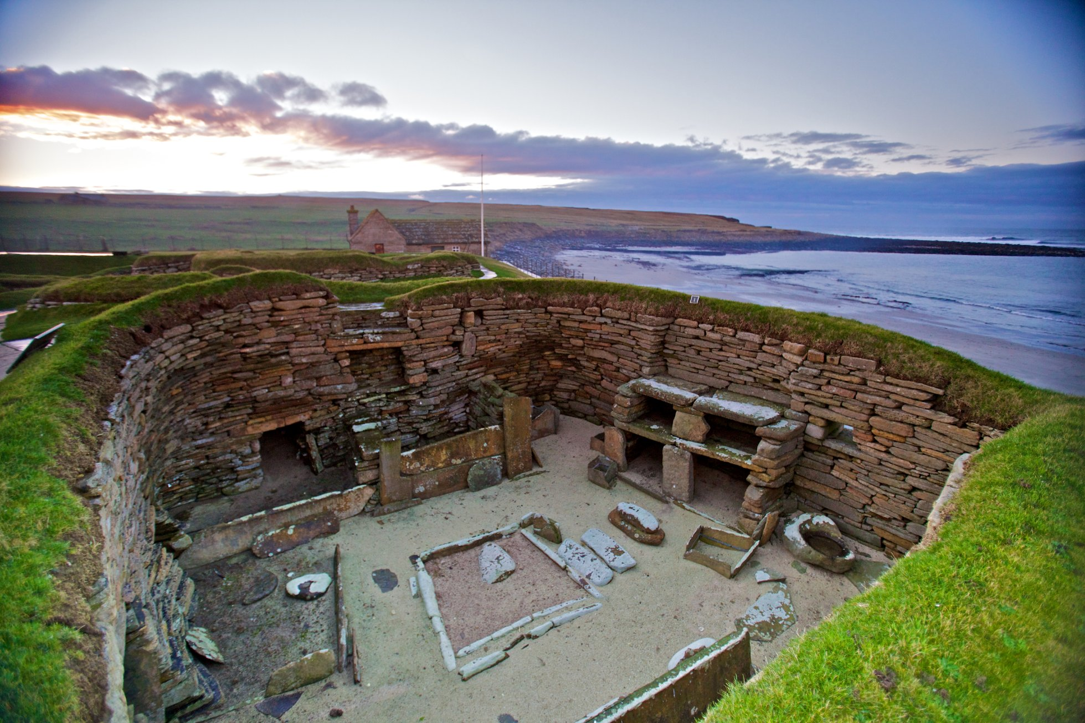
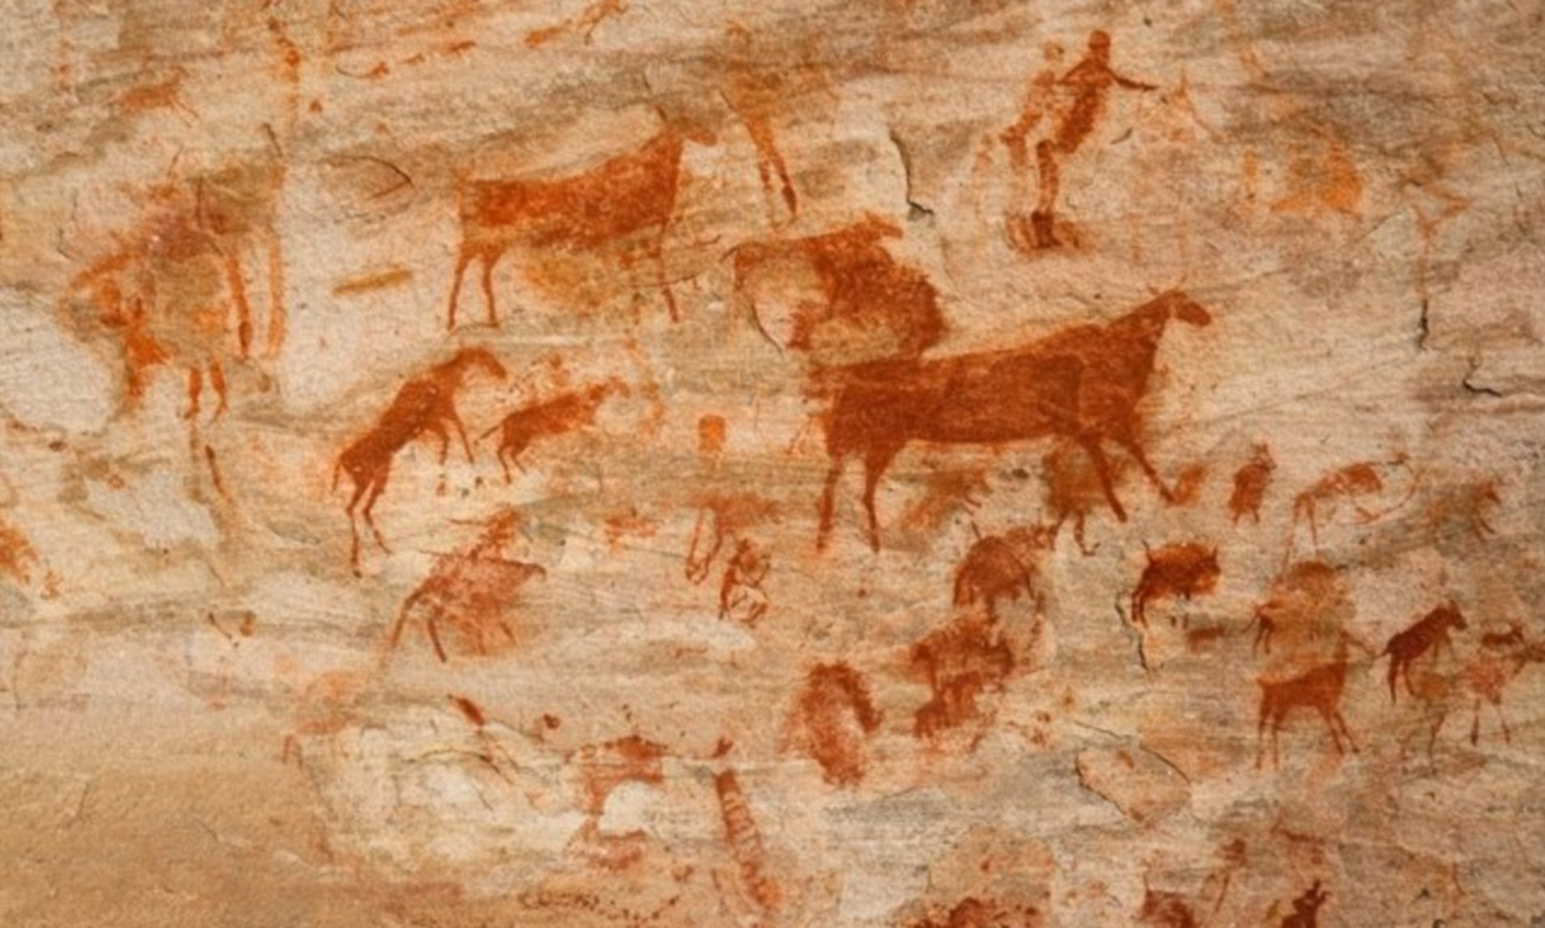
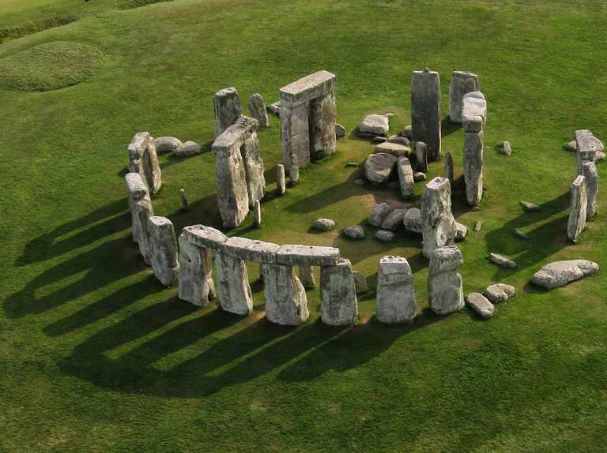
Year 3 History – United Kingdom Stone Age to Iron Age
15000 to 3000 BC
3,300 BC
800 BC
700 BC
43 AD
410
AD
793 AD
900 AD
1066AD
1485 AD
1666 AD
1837 AD
1914 to 1918
1939 to 1945
Now
3100 BC
Stone Age
Bronze Age
Ancient Egyptians
Iron Age
Ancient Greeks
Roman Britain
Anglo Saxons
Vikings
Benin Kingdom formed.
Normans
Tudors
Great Fire of London
Victorians
World War I
World War II
Me!
What You Should Know Already
Skara Brae is an archaeological site in Orkney, Scotland. It is a Stone Age village. There are 8 single room homes made of stone. It is famous because it has been well preserved and has taught us a lot about life in the Stone Age.
Important Vocabulary
1 | Archaeologist | Person who learns about the past by digging up artefacts and studying them.
2 | Artefact | An old object made by a human being.
3 | Archaeological site | A place that has a unique history and is of special interest to historians and archaeologists.
4 | Hunter Gatherers | People who found food from their local environment and then moved from site to site depending on the season. They moved wherever they needed to get food from.
5 | Flint | A type of stone that can be shaped into blades, knives and spears for hunting
6 | Settlement | A place where a group of people live together in many buildings.
7 | Agriculture | The practice of farming and growing crops.
8 | Pre-historic | the time before recorded history
I can talk about the past and understand the passing of time.
I can understand the difference between fact and fiction
I can identify similarities and differences between different ways of life in different time periods.
I am beginning to understand how to find out about the past and can represent my research in different ways.
Cave painting was important to Stone Age man as this was how they recorded history and told others about wild animas and other dangers
Stonehenge is one of the world’s most famous monuments, which stands on Salisbury Plain in Wiltshire. It began being built around 3000 BC. The last changes were made to it were in the early Bronze Age, around 1500 BC. No one really know why it was built but it is thought that people gathered there for pagan religious ceremonies.

Slide 2
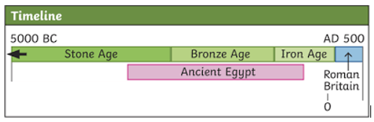
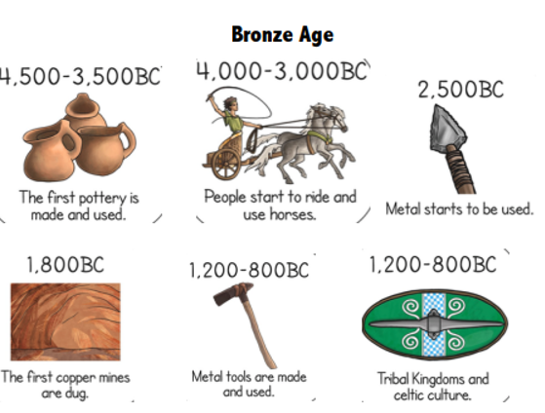
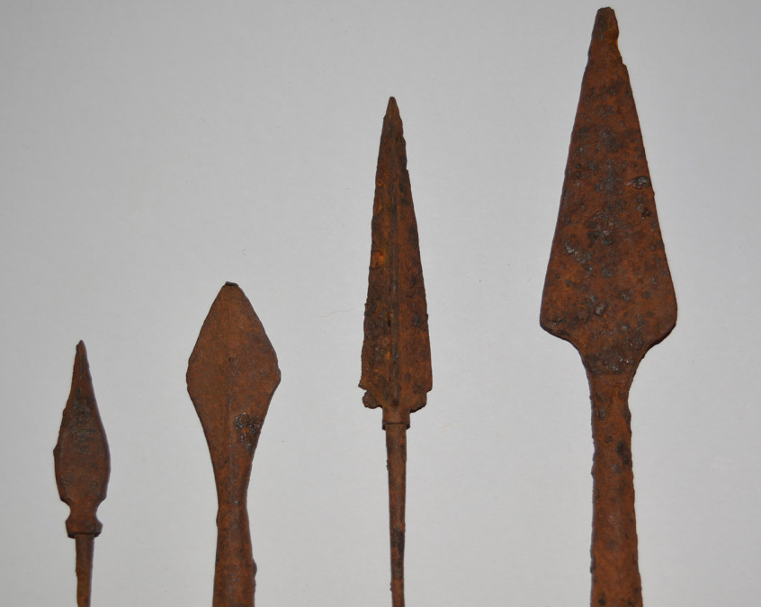
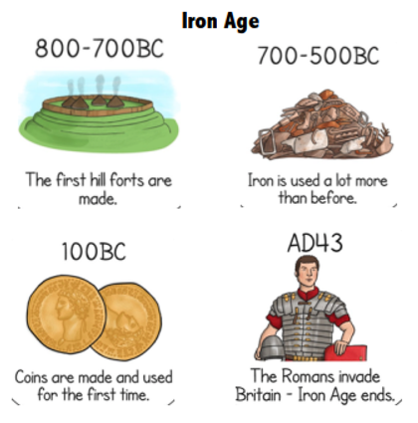
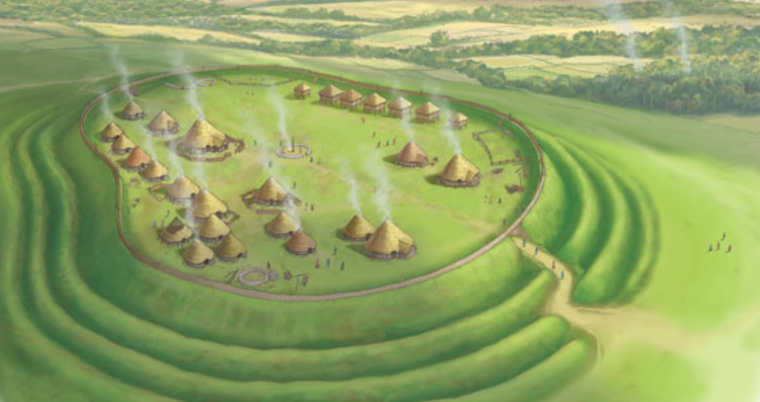
Key Facts
1 | Stone Age | When the first humans began to live in Europe. They used stones as tools.
2 | Bronze Age | In this era, metals were used to make hunting tools. Humans also began to farm land.
3 | Iron Age | Humans now used iron to make tools, and farmed land instead of hunting. They lived in small settlements.
4 | BC | Before Christ. A way of dating years before the birth of Jesus. The bigger the number BC, the longer ago in history it was.
5 | AD | Anno Domini. “In the year of our Lord”. AD is used to show dates after the birth of Jesus. This year is AD 2022
At the start of the Bronze Age, humans started to use metal for tools for the first time. Bronze tools soon replaced stone versions as they were stronger.
Other Sources of Information.
Websites
- https://www.bbc.co.uk/bitesize/topics/z82hsbk
- https://www.english-heritage.org.uk/visit/places/stonehenge/
https://www.historicenvironment.scot/visit-a-place/places/skara-brae/
Brilliant Books: Here are some reading books that you might find interesting:
Stone Age Boy by Satoshi Kitamura
Early Britons: Stone Age to Iron Age Book by Izzi Howell
The First Drawing by Mordicai Gerstein
Iron-Age tribes built strong hill forts, on hilltops and surrounded by huge banks (mounds) of soil and ditches. These strongholds were built for protection.

