Slide 1

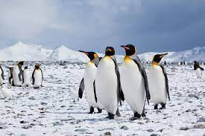
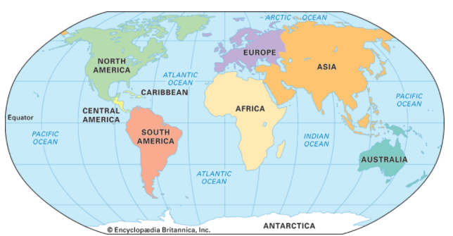
Year 2 Geography – Extremes (Antarctica)
What You Should Know Already
Important Vocabulary
Continent | A very large landmass.
Southern Hemisphere | The half sphere of Earth which is South of the equator.
Weather | Weather is what is happening outside now. The weather is different in different places around the planet.
Climate | The average weather over a long period of time
Iceberg | A large piece of ice floating in the sea.
Ice cap | A thick layer of ice and snow.
Explorer | A person who travels in search of geographical or scientific information
Expedition | A journey for a particular purpose
Frostbite | A condition caused by extreme cold which destroys parts of the body, like ears, fingers, toes, nose.
South Pole | The southernmost point on Earth
Historical evidence | Anything left over from the past is a source of evidence.
I know the name of our continent, Europe and the nearest ocean - Atlantic Ocean.
I can ask questions about a location ‘what is this place like?
I can discuss the daily weather and seasonal changes in Portsmouth.
I am beginning to use basic geographical vocabulary in context to Portsmouth.
Use maps, atlas, globes, books, stories and other information to find out about places.
Although Penguins waddle and hop awkwardly on land and ice, they are extremely quick in the water. The Antarctica is a perfect home for them as there is lots of food in the ocean and few predators.

Slide 2
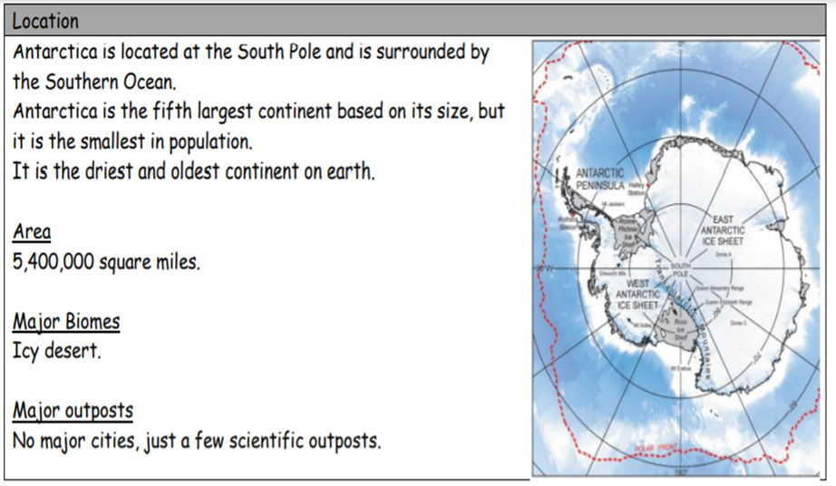
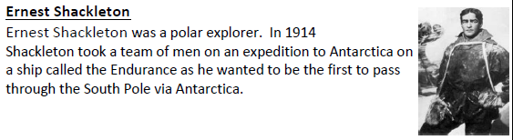
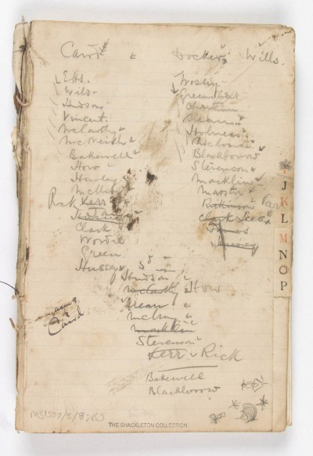
Key Antarctic Explorers
1 | Captain Robert Scott | was an English Royal Navy officer and explorer that led two dangerous missions to the Antarctic in 1902 and 1910.
2 | Sir Ernest Shackleton | He went to Antarctica four times between 1901 and 1922. One of his ships was the Endurance.
3 | Roald Amundsen | Roald Amundsen was a Norwegian explorer. He became the first man to the South Pole on December 14, 1911
4 | Richard Byrd | Made the first flight over the South Pole on 29 November 1929.
5 | Captain Preet Chandi | The first woman of colour to complete a solo trek to the South Pole, on 7th January 2022.
Other Sources of Information
No lives were lost during the 20 months the ship and the team of explorers were stranded on the Antarctic ice sheet.
Websites - www.coolantarctica.com
ttps://www.sciencekids.co.nz/sciencefacts/earth/antarctica.html
https://www.bbc.co.uk/bitesize/topics/zyhp34j/articles/zjg46v4
Brilliant Books: :
The Penguin Who Wanted to Find Out by Jill Tomlinson & Paul Howard
The Great Explorer by Chris Judge
A primary source of evidence is Ernest Shackleton’s diary which he used to record what was happening for the entire time Endurance was trapped on the ice.
Sources of Evidence
Books | Film
Photographs | Websites
Diary

