Slide 1

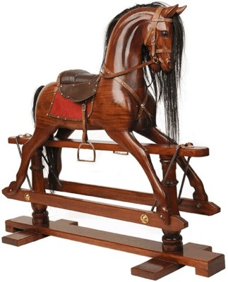
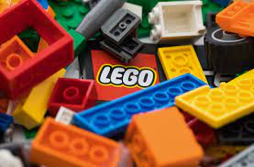
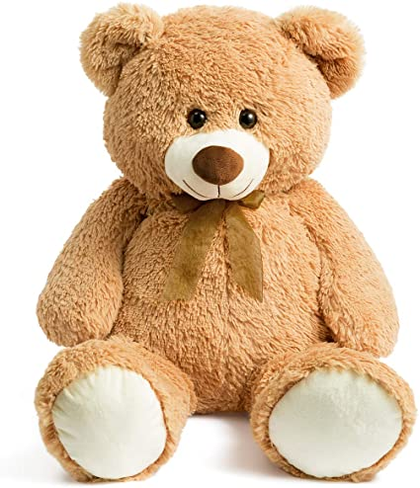
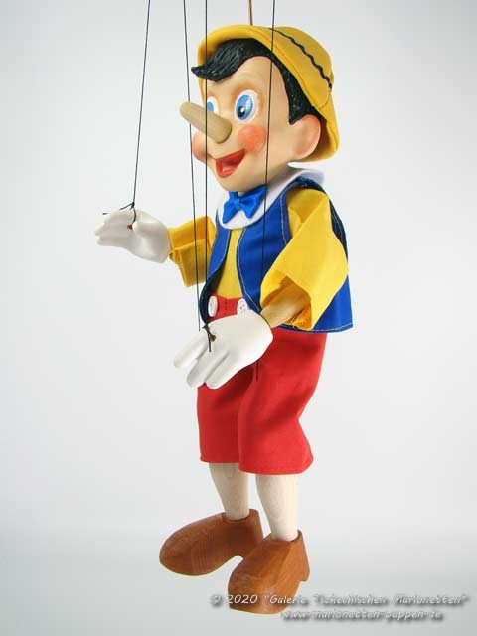
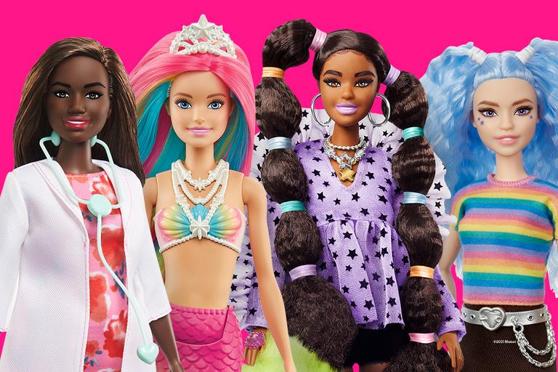
Year 1 History - Toys
15000 to 3000 BC
3,300 BC
800 BC
700 BC
43 AD
410
AD
793 AD
900 AD
1066AD
1485 AD
1666 AD
1837 AD
1914 to 1918
1939 to 1945
Now
3100 BC
Stone Age
Bronze Age
Ancient Egyptians
Iron Age
Ancient Greeks
Roman Britain
Anglo Saxons
Vikings
Benin Kingdom formed.
Normans
Tudors
Great Fire of London
Victorians
World War I
World War II
Me!
Important Vocabulary
1 | past | Any time before today – yesterday, last week, last year.
2 | present | now, the current time.
3 | new | Something that has been made now or recently. New toys are often clean, shiny, not broken and made of plastic.
4 | old | Things are old if they have been around for a long time. An old toy may be worn/bare, ripped, faded, dirty or broken.
5 | different | Things that are not the same about two or more objects, toys or people.
6 | similar | Things that are the same about two or more objects, toys or people.
7 | wooden toys | Lots of toys were made of wood in the past. Boats, train sets and puppets were all made of wood.
8 | plastic toys | Most modern toys are made of plastic. Dolls, ride on cars, train sets and dolls houses are usually made of plastic.
9 | electronic toys | Electronic toys need electricity or batteries to work. Lots of toys today are electronic: games consoles, iPad, karaoke games and dance mats
10 | metal toys | Toy soldiers and spinning tops were made from metal in the past . Today, toy cars, bikes and scooters are metal.
11 | puppet | a movable model of a person or animal that works by either pulling strings or by a hand inside it.
Teddy bear
Plastic bricks
Rocking horse
Dolls
Puppet
What You Should Know Already
I know how old I am and that I am in Year 1
I know that my parents and grandparents are older than me
I may have younger brothers or sisters.
I know the names of the toys I play with now
I know the past existed before my grandparents were alive.

Slide 2
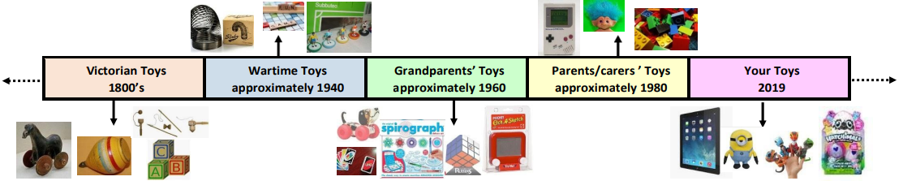
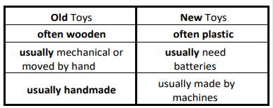
Toy Timeline
Victorian Toys 1800’s | Wartime Toys around 1940 | Grandparents’ Toys approximately 1960 | Parents/carers ’ Toys approximately 1980 | Your toys 2022
Can you find out?
What was your first ever toy?
What toys did your parents and grandparents play with?
Why are the different? How are they similar?
Can you talk about?
Your favourite toy and why you like it?
What your toy is made out of?
What is the difference between your toys and the toys children played with in the past?
How does your toy work?
Is it electronic?
Do you pull it or push it?
What do you think toys will be like in the future?
Brilliant Books
Here are some fiction and non-fiction books that you could share with your child:
The Adventures of Pinocchio (1883) by Carlo Collodi (and the Disney film version)
Old Bear by Jane Hissey
Toys in Space by Mini Grey
Lost in the Toy Museum: An Adventure by David Lucas
‘What Was It Like in the Past: Toys’by Kamini Khanduri
‘In the Past: Toys’ by Dereen Taylor
Toys and Games Then and Now by Robin Nelson.

