Slide 1

Year 6 History – British Inventors, Pioneers and Explorers.
15000 to 3000 BC
3,300 BC
800 BC
700 BC
43 AD
410
AD
793 AD
900 AD
1066AD
1485 AD
1666 AD
1837 AD
1914 to 1918
1939 to 1945
Now
3100 BC
Stone Age
Bronze Age
Ancient Egyptians
Iron Age
Ancient Greeks
Roman Britain
Anglo Saxons
Vikings
Benin Kingdom formed.
Normans
Tudors
Great Fire of London
Victorians
World War I
World War II
Modern World
Important Vocabulary
1 | inventor | a person who invented a particular process or device or who invents things as an occupation.
2 | explorer | a person who discovers and explores a new or unfamiliar area.
3 | pioneer | a person who is among the first to research and develop a new area of knowledge or activity.
4 | circumnavigate | To travel all the way around the world.
5 | civil engineer | an engineer who designs and maintains roads, train lines, bridges, and similar structures.
6 | Industrial revolution | Economic and social changes caused by the change from handmade items to mechanical production in large factories.
7 | construct | To build something from basic material parts.
8 | historical source | Something that provides information about the past such as paintings, manuscripts, or artefacts.
9 | primary sources | Primary sources can be described as those sources that are closest to the origin of the information.
10 | secondary Sources | Secondary sources often interpret or make more concise information from primary sources. Examples include textbooks, articles, and reference books.
What You Should Know Already
Key People
1 | Sir Francis Drake 1540 - 1596 | English admiral who circumnavigated the globe (1577–80) and was the most renowned seaman of the Elizabethan Age.
2 | Mary Seacole 1805 - 1881 | Mary Seacole was a nurse, a traveller, a businesswoman and a writer from Jamaica, a British colony at the time. She worked helping the sick and wounded soldiers during the Crimean War.
3 | Isambard Kingdom Brunel 1806 - 1859 | A British civil engineer considered one of the greatest figures in engineering history. He created ground-breaking designs and ingenious constructions
4 | Alexander Fleming 1881 - 1955 | Alexander Fleming was a Scottish doctor-scientist who was recognised for discovering penicillin, the first antibiotic. The simple discovery and use of the antibiotic has saved millions of lives.
5 | Sir Francis Chichester 1901 - 1972 | Sir Francis Chichester was a British sailor who was the first person to single-handedly sail around the world making only one stop. He was a pilot during WW” and invented ways to fly using navigation tools not maps.
During the Tudor period European explorers were travelling the world in tall sailing ships to discover new lands to claim for their country.
Christopher Columbus landed on the coast of South America in 1498 and claimed to be the first European to have discovered the new land. Others followed.
A source is something that provides information that we can use to tell us about the past.
Other Sources of Information.
Websites
https://www.bbc.co.uk/bitesize/clips/zhwqxnb - scientific inventions in the Victorian era.
https://www.bbc.co.uk/bitesize/topics/zd8fv9q - British significant people.
https://www.natgeokids.com/uk/?s=history&post_type
Brilliant Books:
Here are some reading books that you might find interesting:
A Mindboggling History of Scientists and Inventors by Izzi Howell
The Story of Sir Francis Drake (Historical Stories) by Rob Childs
Great Adventurers by Alistair Humphries
Everest: The Remarkable Story of Edmund Hillary and Tenzing Norgay by Alexandra Stewart.
Incredible stories of the world’s most ingenious inventors by Robert Winston.

Slide 2
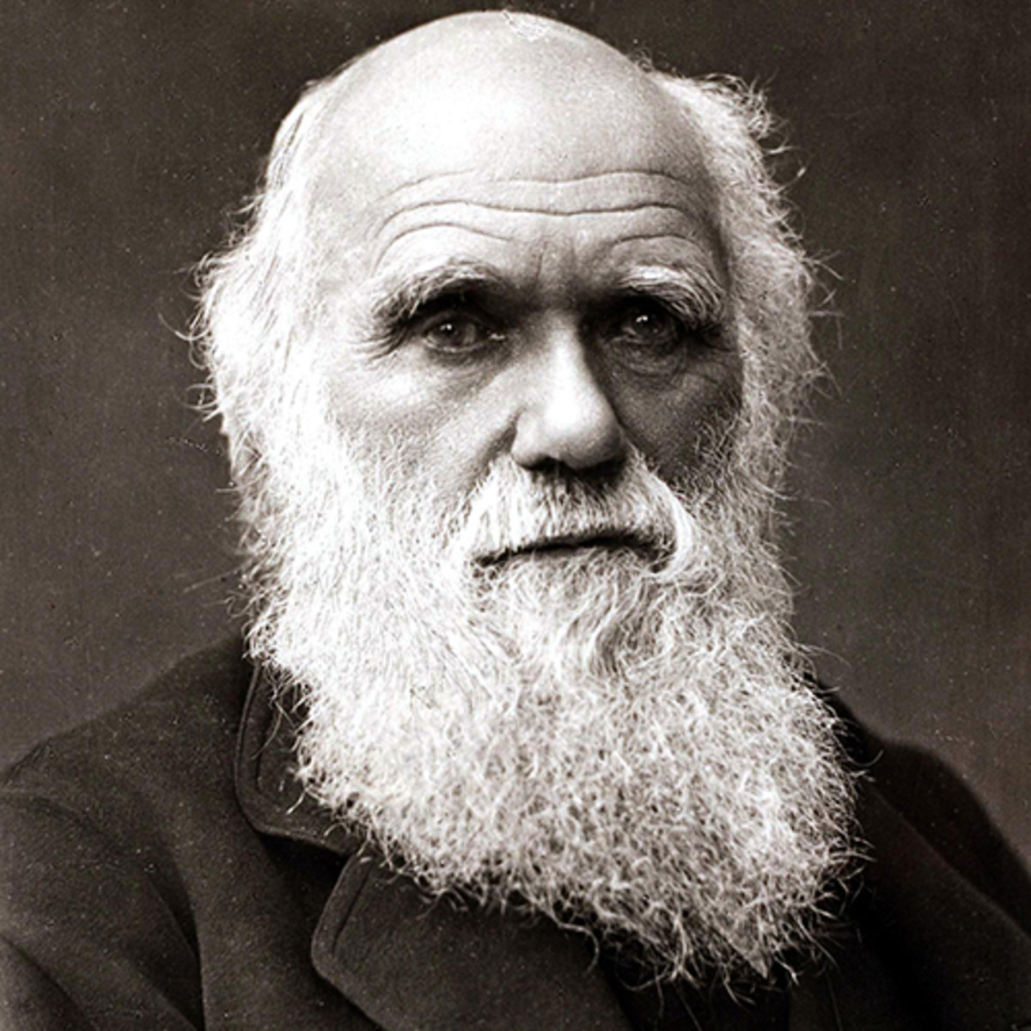
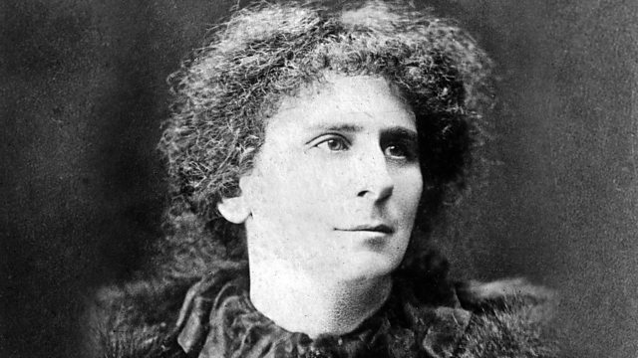
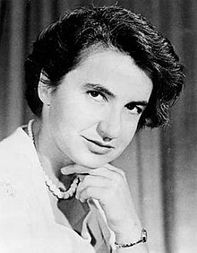
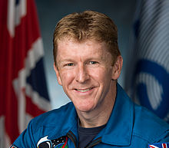
A Timeline of Invention and Exploration
1577 | 1855 | 1831 | 1859 | 1916 | 1928 | 1953 | 1967 | 1972 | 1993 | 2015
Sir Francis Drake set on his circumnavigation voyage from Plymouth. | Mary Seacole opens the British Hotel between Sevastopol and Balaklava in Crimea. | Construction starts on Isambard Kingdom Brunel’s Clifton Suspension Bridge. | Charles Darwin publishes his book called On the Origin of Species. | Hertha Ayrton invents the Ayrton fan which uses wave motion to expel poisonous gas from war trenches. | Alexander Fleming discovers the world’s first antibiotic which he later named penicillin. | Dr Rosalind Franklin’s papers showing the molecular structure of DNA as a double helix was published | Francis Chichester was knighted by Queen Elizabeth II after his solo circumnavigation | Clive Sullivan became the first black captain for Great Britain in any sport. | Jams Dyson launched the first Dyson vacuum cleaner in the UK. | Tim Peake became the first British ESA astronaut to travel in space.
Some More British Inventors, Pioneers or Explorers
Charles Darwin (1809-1882) was an English naturalist, geologist and biologist. He is best known for his contributions to the science of evolution. His book On the Origin of Species (1859) provided evidence that evolution has taken place and suggested a theory to explain how evolution works. This theory is called natural selection.
Hertha Ayrton (1854-1923) was born in Portsmouth. She was a British engineer, mathematician, physicist, inventor and suffragette. She was awarded the Hughes Medal by the Royal Society for her work on electric arcs and ripple marks in sand and water. After the outbreak of WW1, Ayrton put her knowledge of oscillation in water to the movement in air to good use as part of the British war effort to design a fan to expel poisonous gas from war trenches.
Rosalind Franklin (1920-1958) was an English chemist and X-ray crystallographer whose work was central to the understanding of the molecular structures of DNA, RNA, viruses, coal and graphite. She is best known for her work on the X-ray diffraction images of DNA while at King’s Collage London which led to the discovery of the DNA double helix.
Tim Peake (born in 1972) is a British astronaut and military officer. In 2016, while on a mission to the International Space Station (ISS), became the first official British astronaut to walk in space.

