Slide 1

Year 5 History - Anglo Saxons
15000 to 3000 BC
3,300 BC
800 BC
700 BC
43 AD
410
AD
793 AD
900 AD
1066AD
1485 AD
1666 AD
1837 AD
1914 to 1918
1939 to 1945
Now
3100 BC
Stone Age
Bronze Age
Ancient Egyptians
Iron Age
Ancient Greeks
Roman Britain
Anglo Saxons
Vikings
Benin Kingdom formed.
Normans
Tudors
Great Fire of London
Victorians
World War I
World War II
Me!
Important Vocabulary
1 | archaeology | The study of the past by examining the remains of buildings, tools and other objects.
2 | artefact | An object from the past that was made by a human and shows how they lived – pottery, coins, weapons etc.
3 | invade | To enter a country by force with an army.
4 | monastery | A building where people (often monks) lived and worshipped, devoting their lives to God.
5 | pagans | People who didn’t believe in just one God but worshipped several gods and goddesses.
6 | raiders | People who enter a place illegally, usually to steal.
7 | Runes | An alphabet used to write Old English.
8 | historical source | Something that provides information about the past such as paintings, manuscripts, or artefacts.
9 | thatch | The roof of a building that is made with dried plants such as reeds or straw.
10 | wattle and daub | The weaving of small branches and then covering with a mixture of mud, straw, horse hair and dung to make walls.
What You Should Know Already
Key People
1 | St Augustine (530 – 604 AD) | Augustine of Canterbury was a missionary sent from Rome to convert people from Anglo-Saxon paganism to Christianity. He was considered to be responsible for spreading the Christian faith throughout England.
2 | King Aethelbert (550 – 616 AD) | King of Kent who created the first Germanic law code in the early 7th Century and became the first English king to convert to Christianity from paganism.
3 | King Offa (730 – 796 AD) | King of Mercia, and of most of England in the mid-8th Century. Historians regard him as the most powerful Anglo-Saxon king until Alfred the Great.
4 | King Alfred the Great (849 – 899 AD) | Fought the Vikings and defeated them in the Battle of Edington (878) and thus made an agreement with them (Danelaw). He was known for improving the standard of living, legal and military systems as well as education.
5 | King Cnut (1016 -1035) | A fierce Danish warrior king who was the first Viking King in part of Britain.
The Roman Empire ruled over most of Britain from 43 AD and had created new towns and roads, a new religion and improved skills of reading and counting.
The last Roman soldiers left Britain in 410 AD. There was no longer anyone to defend the population from invaders.
Archaeologists find out about the past by looking at artefacts and different sources of information.
Other Sources of Information.
Websites
https://www.bbc.co.uk/bitesize/topics/zxsbcdm
https://www.dkfindout.com/uk/history/anglo-saxons/
https://www.natgeokids.com/uk/discover/history/general-history/anglo-saxons/
Brilliant Books:
Here are some reading books that you might find interesting:
The Anglo-Saxon Boy by Tony Bradman
Beowulf by Michael Morpurgo
The Buried Crown by Ally Sherrick
The King Who Threw Away His Throne by Terry Deary

Slide 2
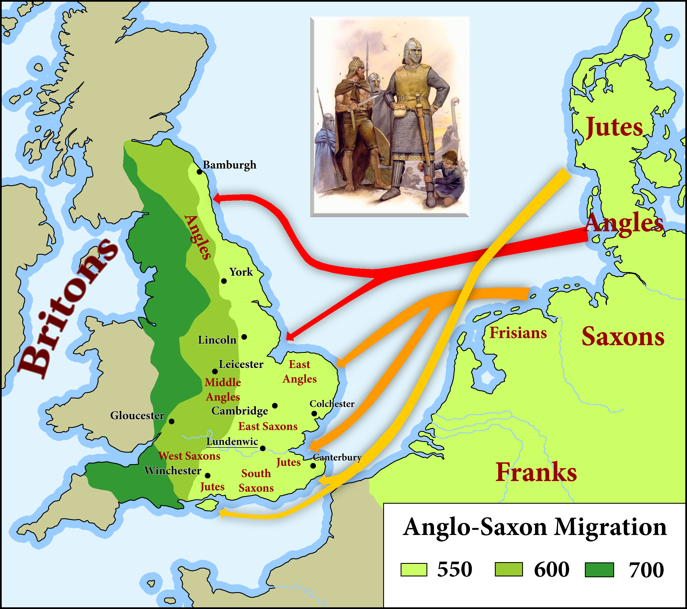
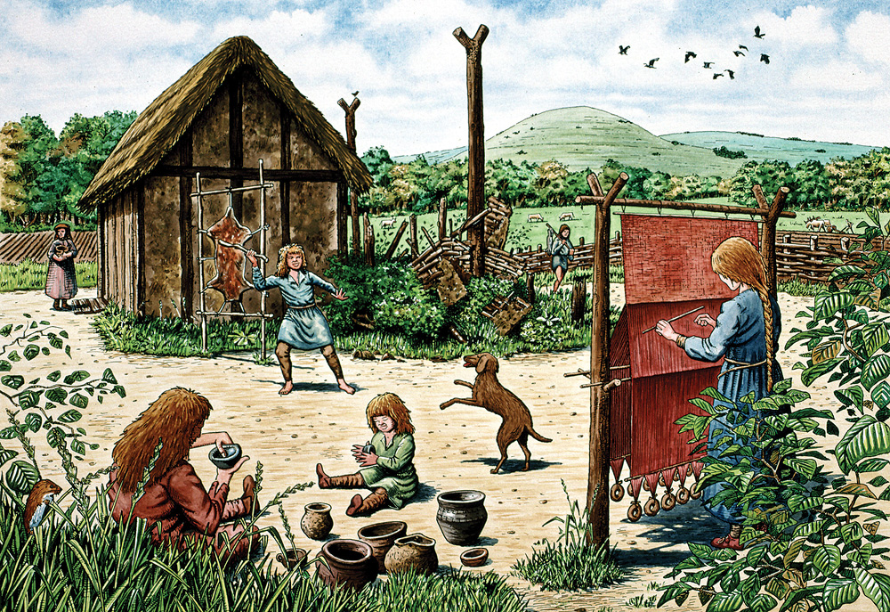
Anglo-Saxon Timeline
410 A.D. | 497 A.D. | 573 A.D. | 586 A.D. | 597 A.D. | 600 A. D | 757 A.D. | 793 A.D. | 871 A.D. | 1016 A.D. | 1066 A.D.
Romans left Britain leaving it unguarded | The kingdom of Wessex is formed | The Kingdom of East Anglia was formed | The Kingdom of Mercia was formed | St. Augustine introduces Christianity | The first monasteries were built. | Offa King of Mercia declares himself king of England | Vikings attack Lindisfarne | Alfred the Great rules | Canute the Great rules as the first Viking | Battle of Hastings Normans defeated by Saxons
Who were the Anglo-Saxons?
They were a mix of different tribes from Germany, Denmark and the Netherlands. The three biggest were the Angles, the Jutes and the Saxons. The land they settled in was called ‘Angle-land’ but they did not conquer Scotland, Wales or Cornwall.
Why did they come to Britain?
Although, some Anglo-Saxons were warriors who came to fight and thought the Britons were weak now the Romans had left others came peacefully to farm. Their homelands in Scandinavia often flooded and is was tough to grow food. They bought their families and created their own houses in settlements away from the old Roman towns.
What was Anglo-Saxon life like?
Anglo Saxon villages were usually very small with no more than a hundred or so people living there. The villagers relied upon the local natural resources for all their essential supplies of water, fuel, building materials and food. The Anglo-Saxons grew crops and kept pigs, sheep and cattle as well as hunting for other animals and fish for food. They made household goods and farm equipment from pottery, wood and metal plus wove cloth from their animals to make clothes. The Anglo-Saxons traded goods, such as hunting dogs and local slaves, for things they couldn't make, like glass, with people from other countries.
To keep the villagers and animals safe, a high, wooden fence would often surround the whole settlement.

