Slide 1

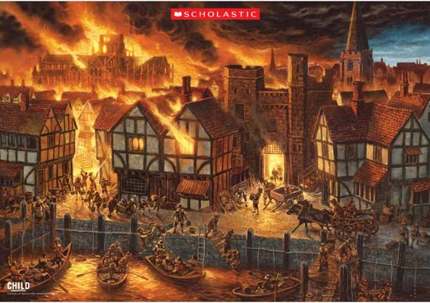
Year 2 History – London’s Burning!
15000 to 3000 BC
3,300 BC
800 BC
700 BC
43 AD
410
AD
793 AD
900 AD
1066AD
1485 AD
1666 AD
1837 AD
1914 to 1918
1939 to 1945
Now
3100 BC
Stone Age
Bronze Age
Ancient Egyptians
Iron Age
Ancient Greeks
Roman Britain
Anglo Saxons
Vikings
Benin Kingdom formed.
Normans
Tudors
Great Fire of London
Victorians
World War I
World War II
Me!
Important Vocabulary
1 | past | the time before now / periods of history before the present day
2 | present | now; the period of time now occurring
3 | differences | things that are NOT the same
4 | similarities | Things that are the same or almost the same.
5 | diary | A written record of events/thoughts. Individuals keep diaries and write in them often
6 | flammable | Something that burns easily.
7 | eye-witness | a person who has seen something and can give a description of it.
8 | thatched roof | a roof made of straw.
What You Should Know Already
Key Facts
1. | The Great Fire of London started in the early hours of the morning of 2 September 1666 and lasted for 5 days.
2. | The fire started in a baker's shop on Pudding Lane.
3. | The fire burned for 5 days and destroyed many Tudor houses and buildings. People escaped on horse and carts towards the River Thames and got boats to safety.
4. | The fire spread so quickly because the Tudor houses were made of wood and had thatched roofs. They were also built very close together so the fire spread easily.
5. | Samuel Pepys watched the fire from his bedroom window and wrote it all down in his diary. This became a very famous diary.
Firefighters are people who help us when there is a fire or an emergency.
Events happened before I was born.
There have been changes to how people live over time.
Events that happened in the past have made a difference to how we live our lives today.
Great Fire of London Timeline
2nd September 1666 | 3rd September 1666 | 4th September 1666 | 5th September 1666 | 6th September 1666
A fire starts in Thomas Farriner’s bakery on Pudding Lane. By 7 am it had spread and already burnt down 300 houses. | People try to put the fire out by using leather buckets of water and fire hooks. They try to stop the fire spreading by pulling down houses. | The fire continues to spread and St Paul’s Cathedral burns down. | The wind changes direction , blowing the fire towards the River Thames. | The Fire of London finally stops because the river acts as a fire-break. Many people are now homeless.

