Slide 1

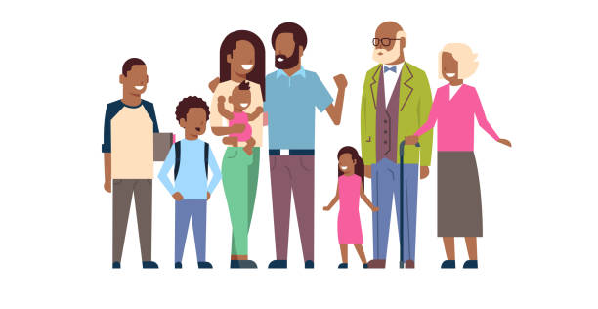
Year 1 Geography – Super Me!
What You Should Know Already
I know my first name and can write it down correctly.
I know how old I am.
I know the names of the people I live with and their relationship to me.
I know I go to St John’s School
Our families are all different.
Important Vocabulary
family | A family is two or more people who are connected. Families can look very different from each other, but they all love and care for each other very much.
now | The present – today.
future | Anything after now – tomorrow, next week, next year.
past | Any time before today – yesterday, last week, last year.
city | A place where lots of people live and work. A city is bigger than a town.
far | Something a long way away - The sea is too far from school to walk.
near | Something that is close - Asda is near to school.
I was born.
I started Reception
Now
2014
2020
2021
Can you add more information to your timeline?
Key Facts I Need to Know
I go to school at St John’s Cathedral Catholic Primary School.
I know people live in different types of homes.
I can describe people in my family using the words – older/ younger, child or adult.
I know families are all different.

Slide 2
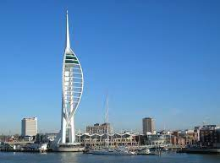
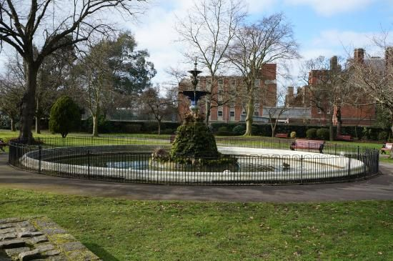
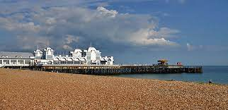
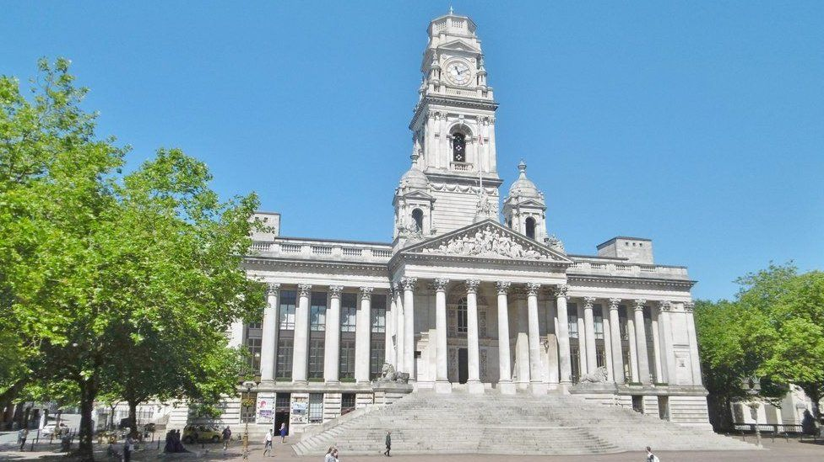
All about Me
I know my address is where I live.
I know I live in Portsmouth, England.
I know some of my family may live near or far away in other countries.
My School
I know how to find my way to the school hall, the art room, the playground and the Trim Trail.
I can draw a simple map of the playground.
I know features that are near or far away from my classroom.
Portsmouth
Portsmouth is a city by the sea.
I can recognise some places near to my home.
I can talk about South Parade Pier and the sea front.
Victoria Park
The Spinnaker Tower
Other Sources of Information.
Websites
https://earth.google.com
https://www.visitportsmouth.co.uk/
Brilliant Books: :
Claude in the City by Alex T. Smith
A Place to Call Home by Ellen Lawrence
Katie Morag and the New Pier by Marri Hedderwick
South Parade Pier
The Guildhall

